Slide 1

Green Pace
Security Policy Presentation
Developer: Anthony Lewandowski

Slide 2

OVERVIEW: DEFENSE IN DEPTH
I am introducing the new Green Pace security policy for a safer, more secure work environment. The primary purpose of this security policy is to create basic rules and procedures for all individuals working in the development environment. Following the rules and procedures in this security policy will help ensure that everyone at Green Pace is doing their part to support secure coding.

Slide 3
THREATS MATRIX
Likely STD - 002 - CPP STD - 003 – CPP STD – 005 – CPP STD – 007 – CPP STD – 010 - CPP | Priority The higher the priority number the higher chance there is for a threat.
Low priority Low priority security measures should not be ignored. These will leave an opportunity open for an attack. | Unlikely STD – 001 – CPP STD – 004 – CPP STD – 006 – CPP STD – 008 – CPP STD – 009 - CPP

Slide 4
10 PRINCIPLES
1. Validate Input Data
2. Heed Compiler Warnings
3. Architect and design for security policies
4. Keep it Simple
5. Default Deny
6. Adhere to the principle of least privilege
7. Sanitize data sent to other systems
8. Practice Defense in Depth
9. Use Effective QA techniques
10. Adopt a secure coding standard

Slide 5
CODING STANDARDS
1. Data Input
2. Data Value
3. String Correctness
4. SQL Injection
5. Memory Protection
6. Assertions
7. Exceptions
8. Error Handling
9. Integer Conversion
10. Input Output

Slide 6
ENCRYPTION POLICIES
Encryption in rest
Taking one form of data and transforming it into another to protect sensitive information.
Excellent for data not often used.
Encryption in flight
Encrypting data while it is being transferred.
Will protect data from a mid transfer attack.
This should be used frequently if transferring sensitive data.
Encryption in use
All around encryption of data for both in use or at rest.
Will prevent data loss
This policy will provide a practical approach for protecting all company data.

Slide 7
TRIPLE-A POLICIES
Authentication
Identify a user with a user name and password
First line of defense against unwanted users.
Authorization
Checks the users permissions within a system.
Provides users with permissions.
Another security layer to keep unwanted users out.
Accounting
Monitor and log user activity.
Used to determine type of permissions to give a user.
Good for tracking malicious activity.

Slide 8
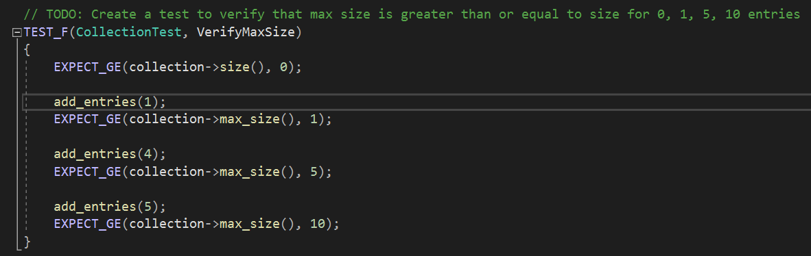
Unit Testing
Testing to verify the max size of a collection

Slide 9
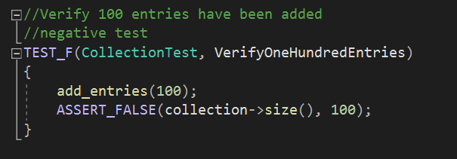
Unit Testing
Testing to verify 100 entries have been added to a collection

Slide 10
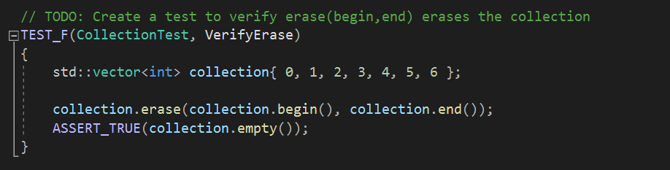
Unit Testing
Testing to verify collection.erase erases the collection

Slide 11
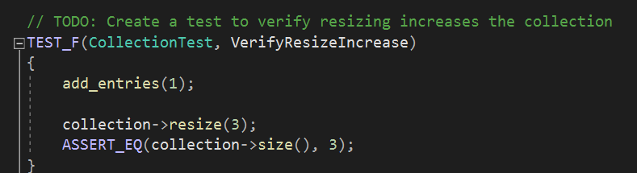
Unit Testing
Testing to verify resizing increases a collection

Slide 12

AUTOMATION SUMMARY

Slide 13
TOOLS
The DevSecOps pipeline is a process of integrating security into the software development life cycle. The process contains security practices to build test and deploy secure software.
External tools used in the pipeline may vary, but an example may be automated test frameworks. Automated test frameworks could aid in exhaustive testing and could be found in testing, health checks, and the monitoring areas of the diagram on the previous slide.

Slide 14
RISKS AND BENEFITS
Risks
Leaving security problems until the end of a project can be costly.
Vulnerabilities in code can multiply creating missed deadlines.
Benefits
Creating software with security in mind will help to reduce cost.
Developing in increments will help reduce code vulnerabilities and will produce a more secure product.

Slide 15
RECOMMENDATIONS
Two potential gaps not covered in this security policy would be
1. processes on how to deal with third party/ vendor risks.
2. procedures on how to deal with incident handling.

Slide 16
CONCLUSIONS
To build on what was mentioned in the recommendations slide, a structured procedure on how to deal with incidents before they occur would be highly advantageous to preventing problems that might occur in the moment.
Procedures on investigating third part vendors would also be an excellent standard to set to ensure sensitive company information is secured.

